Slide 1
Chapter 3
Multiple Regression Analysis: Estimation

Slide 2
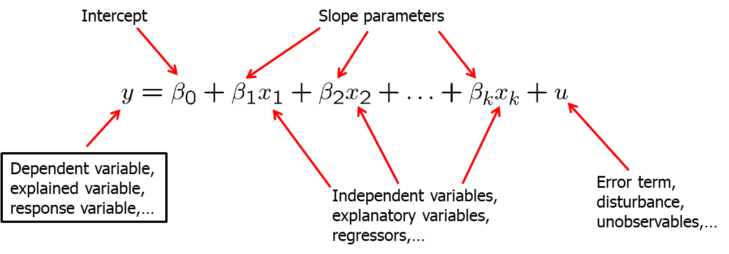
Multiple Regression Analysis: Estimation (1 of 37)
Definition of the multiple linear regression model
“Explains variable y in terms of variables x₁, x₂,…, x_{k}”

Slide 3
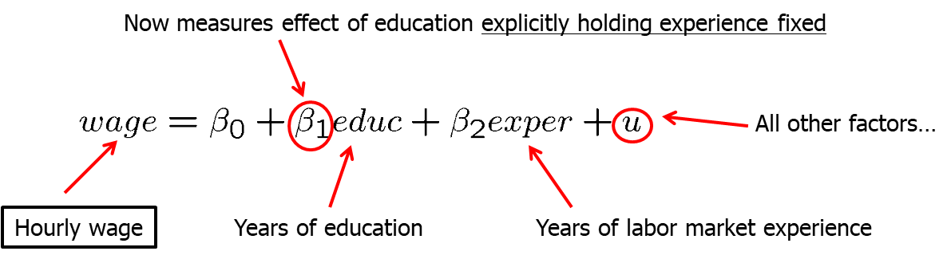
Multiple Regression Analysis: Estimation (2 of 37)
Motivation for multiple regression
Incorporate more explanatory factors into the model
Explicitly hold fixed other factors that otherwise would be in
Allow for more flexible functional forms
Example: Wage equation

Slide 4
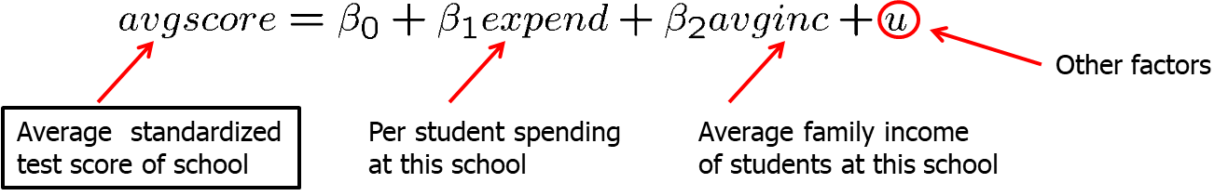
Multiple Regression Analysis: Estimation (3 of 37)
Example: Average test scores and per student spending
Per student spending is likely to be correlated with average family income at a given high school because of school financing.
Omitting average family income in regression would lead to biased estimate of the effect of spending on average test scores.
In a simple regression model, effect of per student spending would partly include the effect of family income on test scores.

Slide 5
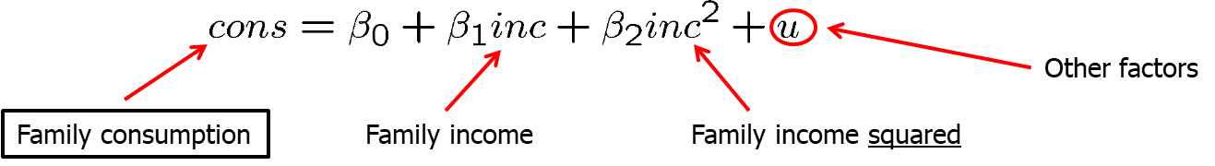
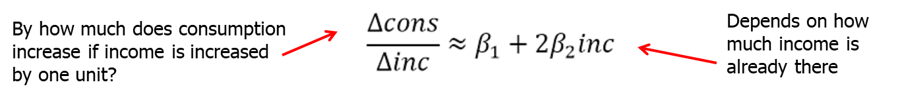
Multiple Regression Analysis: Estimation (4 of 37)
Example: Family income and family consumption
Model has two explanatory variables: inome and income squared
Consumption is explained as a quadratic function of income
One has to be very careful when interpreting the coefficients:

Slide 6
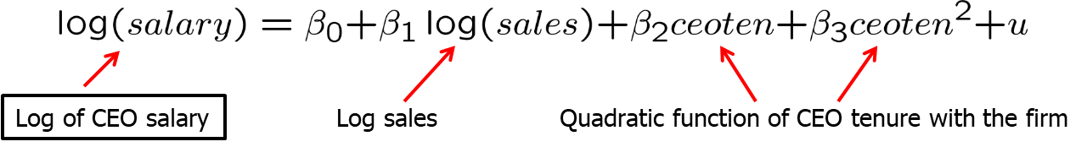
Multiple Regression Analysis: Estimation (5 of 37)
Example: CEO salary, sales and CEO tenure
Model assumes a constant elasticity relationship between CEO salary and the sales of his or her firm.
Model assumes a quadratic relationship between CEO salary and his or her tenure with the firm.
Meaning of “linear” regression
The model has to be linear in the parameters (not in the variables)

Slide 7

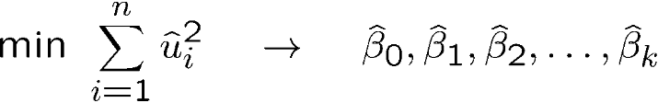
Multiple Regression Analysis: Estimation (6 of 37)
OLS Estimation of the multiple regression model
Random sample
Regression residuals
Minimize sum of squared residuals

Slide 8
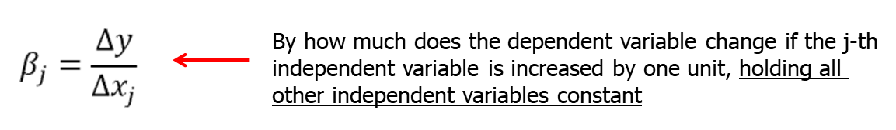
Multiple Regression Analysis: Estimation (7 of 37)
Interpretation of the multiple regression model
The multiple linear regression model manages to hold the values of other explanatory variables fixed even if, in reality, they are correlated with the explanatory variable under consideration.
“Ceteris paribus”-interpretation
It has still to be assumed that unobserved factors do not change if the explanatory variables are changed.

Slide 9
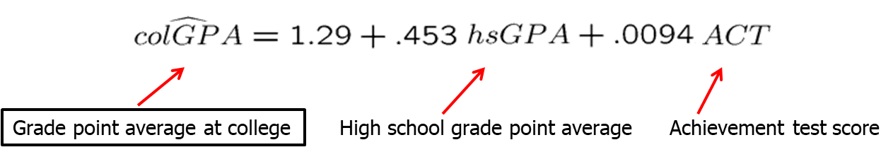
Multiple Regression Analysis: Estimation (8 of 37)
Example: Determinants of college GPA
Interpretation
Holding ACT fixed, another point on high school grade point average is associated with another .453 points college grade point average
Or: If we compare two students with the same ACT, but the hsGPA of student A is one point higher, we predict student A to have a colGPA that is .453 higher than that of student B
Holding high school grade point average fixed, another 10 points on ACT are associated with less than one point on college GPA

Slide 10
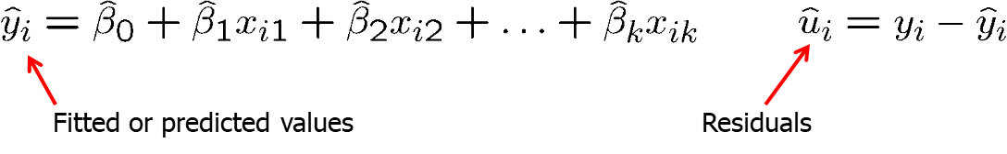
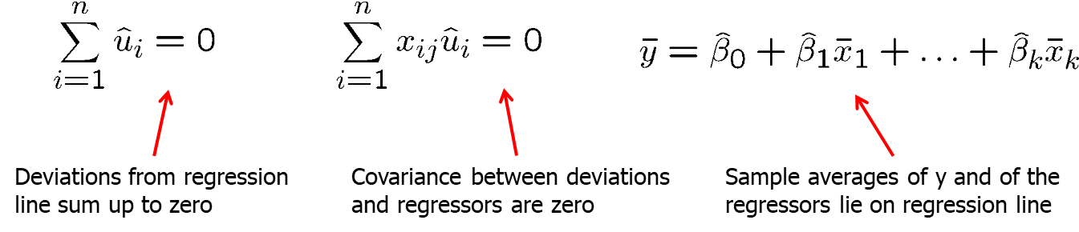
Multiple Regression Analysis: Estimation (9 of 37)
Properties of OLS on any sample of data
Fitted values and residuals
Algebraic properties of OLS regression

Slide 11
Multiple Regression Analysis: Estimation (10 of 37)
“Partialling out” interpretation of multiple regression
One can show that the estimated coefficient of an explanatory variable in a multiple regression can be obtained in two steps:
1) Regress the explanatory variable on all other explanatory variables
2) Regress on the residuals from this regression
Why does this procedure work?
The residuals from the first regression is the part of the explanatory variable that is uncorrelated with the other explanatory variables.
The slope coefficient of the second regression therefore represents the isolated effect of the explanatory variable on the dep. variable.

Slide 12

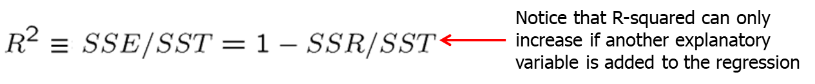
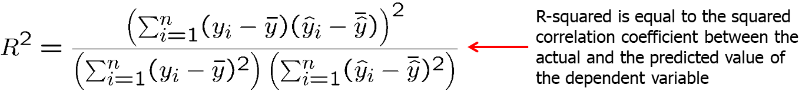
Multiple Regression Analysis: Estimation (11 of 37)
Goodness-of-Fit
Decomposition of total variation
R squared
Alternative expression for R squared

Slide 13
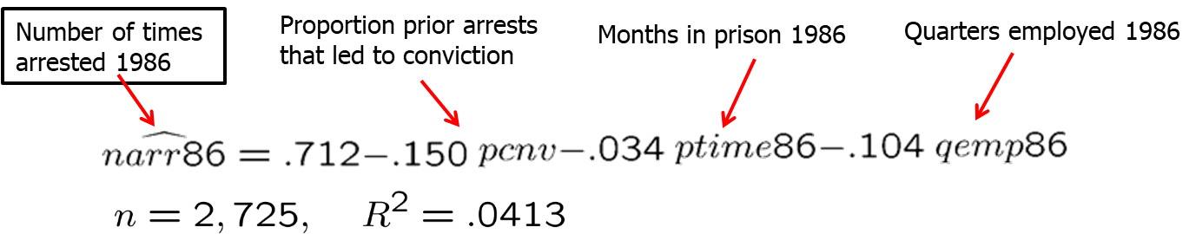
Multiple Regression Analysis: Estimation (12 of 37)
Example: Explaining arrest records
Interpretation:
If the proportion prior arrests increases by 0.5, the predicted fall in arrests is 7.5 arrests per 100 men.
If the months in prison increase from 0 to 12, the predicted fall in arrests is 0.408 arrests for a particular man.
If the quarters employed increase by 1, the predicted fall in arrests is 10.4 arrests per 100 men.

Slide 14
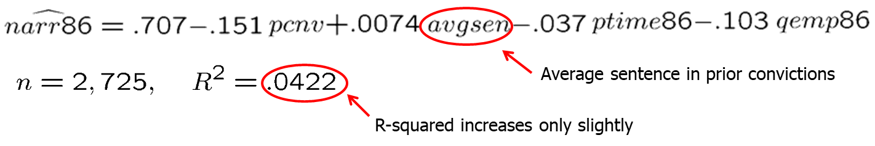
Multiple Regression Analysis: Estimation (13 of 37)
Example: Explaining arrest records (cont.)
An additional explanatory variable is added.
Interpretation:
Average prior sentence increases number of arrests (?)
Limited additional explanatory power as R-squared increases by little
General remark on R-squared
Even if R-squared is small (as in the given example), regression may still provide good estimates of ceteris paribus effects.

Slide 15
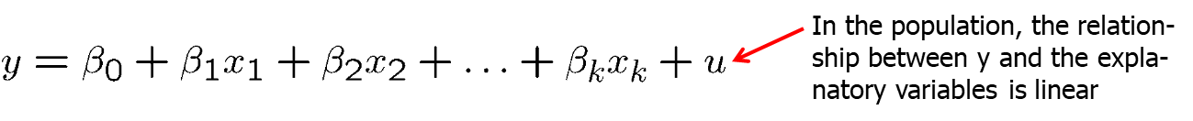
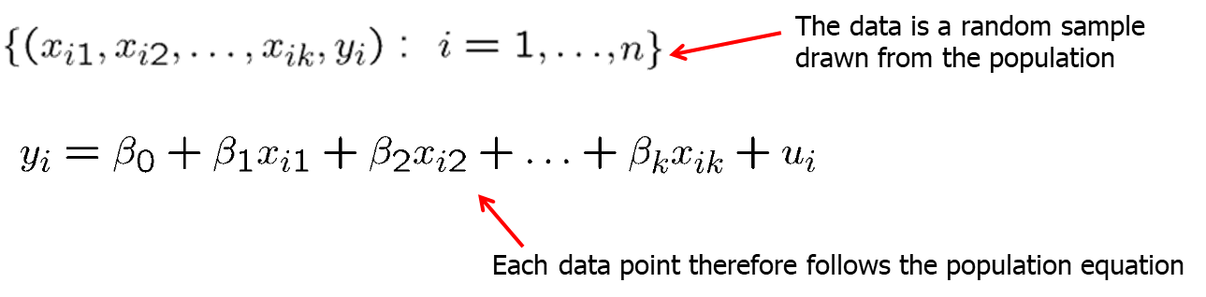
Multiple Regression Analysis: Estimation (14 of 37)
Standard assumptions for the multiple regression model
Assumption MLR.1 (Linear in parameters)
Assumption MLR.2 (Random sampling)

Slide 16
Multiple Regression Analysis: Estimation (15 of 37)
Standard assumptions for the multiple regression model (cont.)
Assumption MLR.3 (No perfect collinearity)
In the sample (and therefore in the population), none of the independent variables is constant and there are no exact linear relationships among the independent variables.
Remarks on MLR.3
The assumption only rules out perfect collinearity/correlation bet-ween explanatory variables; imperfect correlation is allowed.
If an explanatory variable is a perfect linear combination of other explanatory variables it is superfluous and may be eliminated.
Constant variables are also ruled out (collinear with intercept).

Slide 17
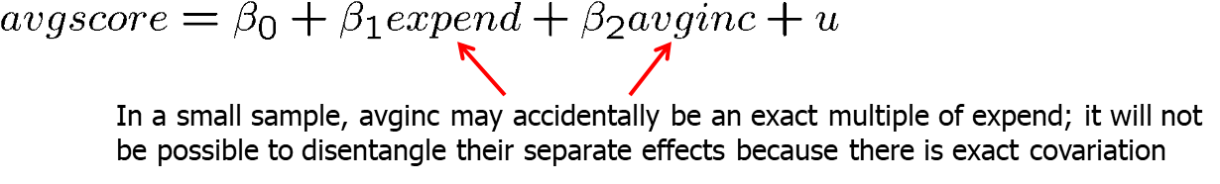
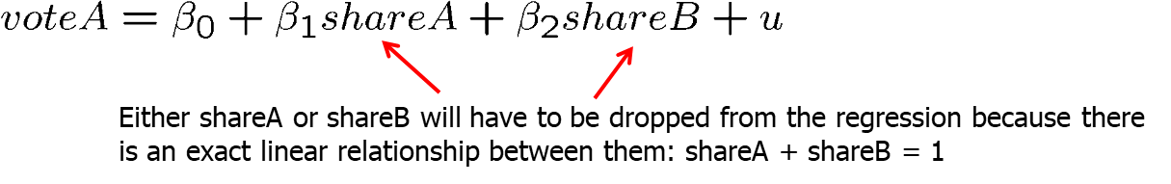
Multiple Regression Analysis: Estimation (16 of 37)
Example for perfect collinearity: small sample
Example for perfect collinearity: relationships between regressors

Slide 18
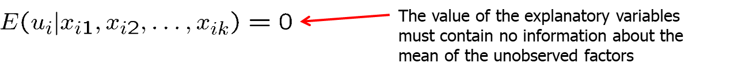
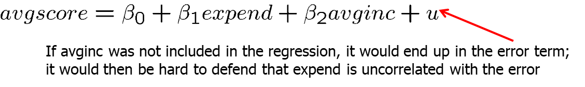
Multiple Regression Analysis: Estimation (17 of 37)
Standard assumptions for the multiple regression model (cont.)
Assumption MLR.4 (Zero conditional mean)
In a multiple regression model, the zero conditional mean assumption is much more likely to hold because fewer things end up in the error.
Example: Average test scores

Slide 19
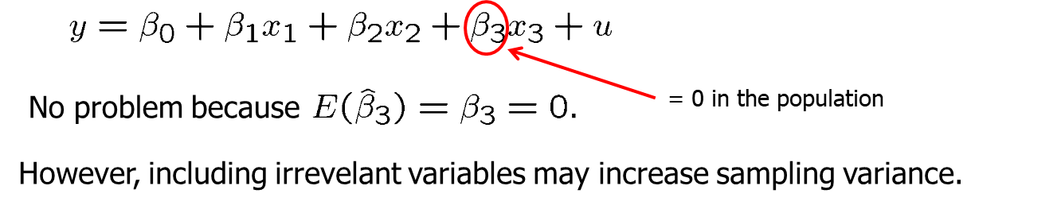
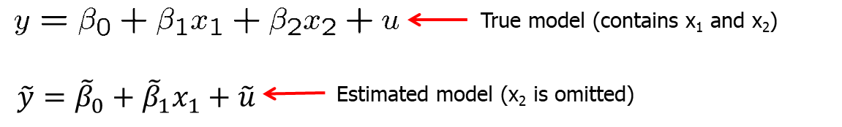
Multiple Regression Analysis: Estimation (18 of 37)
Including irrelevant variables in a regression model
Omitting relevant variables: the simple case

Slide 20
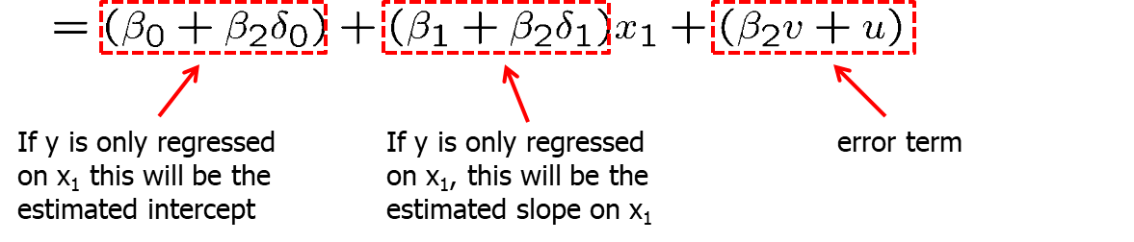
Multiple Regression Analysis: Estimation (19 of 37)
Omitted variable bias
Conclusion: All estimated coefficients will be biased

Slide 21
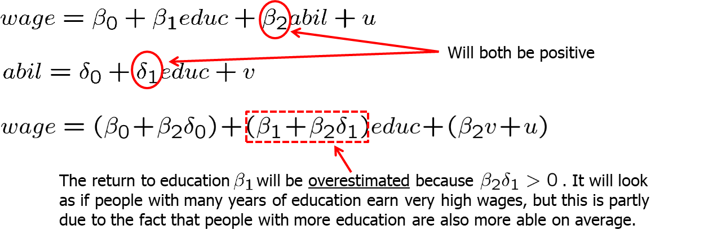
Multiple Regression Analysis: Estimation (20 of 37)
Example: Omitting ability in a wage equation
When is there no omitted variable bias?
If the omitted variable is irrelevant or uncorrelated

Slide 22
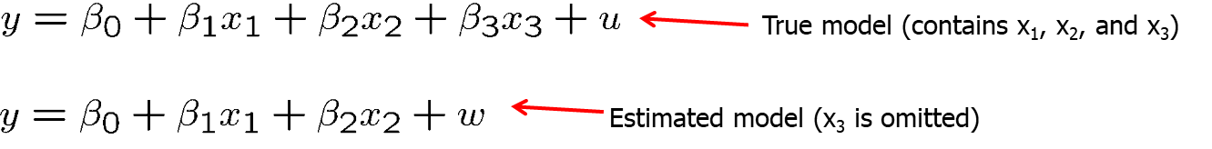
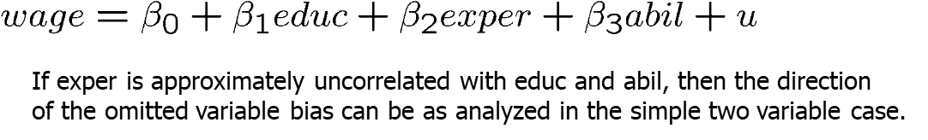
Multiple Regression Analysis: Estimation (21 of 37)
Omitted variable bias: more general cases
No general statements possible about direction of bias
Analysis as in simple case if one regressor uncoreelated with others
Example: Omitting ability in a wage equation

Slide 23
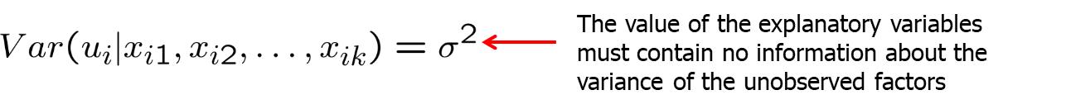
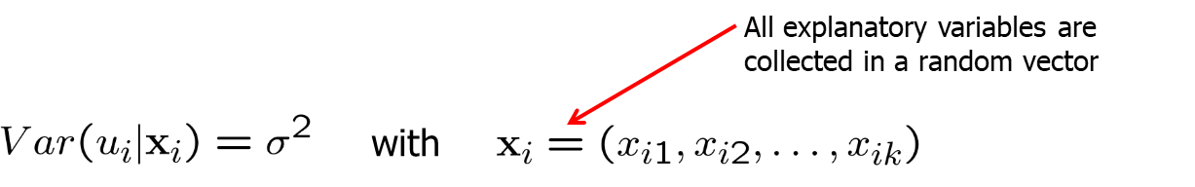
Multiple Regression Analysis: Estimation (22 of 37)
Standard assumptions for the multiple regression model (cont.)
Assumption MLR.5 (Homoskedasticity)
Example: Wage equation
Short hand notation

Slide 24
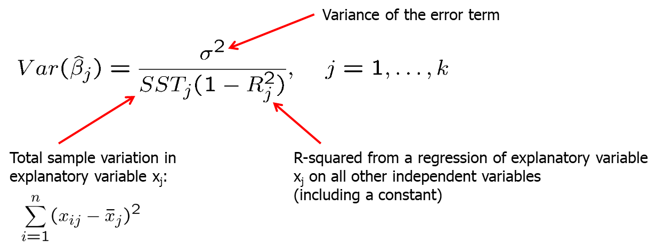
Multiple Regression Analysis: Estimation (23 of 37)
Theorem 3.2 (Sampling variances of the OLS slope estimators)
Under assumptions MLR.1 – MLR.5:

Slide 25
Multiple Regression Analysis: Estimation (24 of 37)
Components of OLS Variances:
1) The error variance
A high error variance increases the sampling variance because there is more “noise” in the equation.
A large error variance doesn‘t necessarily make estimates imprecise.
The error variance does not decrease with sample size.
2) The total sample variation in the explanatory variable
More sample variation leads to more precise estimates.
Total sample variation automatically increases with the sample size.
Increasing the sample size is thus a way to get more precise estimates.

Slide 26
Multiple Regression Analysis: Estimation (25 of 37)
Components of OLS Variances (contd.)
3) Linear relationships among the independent variables
Regress x_{j} on all other independent variables (including constant)
The R-squared of this regression will be the higher when x_{j} can be better explained by the other independent variables.
The sampling variance of the slope estimator for x_{j} will be higher when x_{j} can be better explained by the other independent variables.
Under perfect multicollinearity, the variance of the slope estimator will approach infinity.

Slide 27
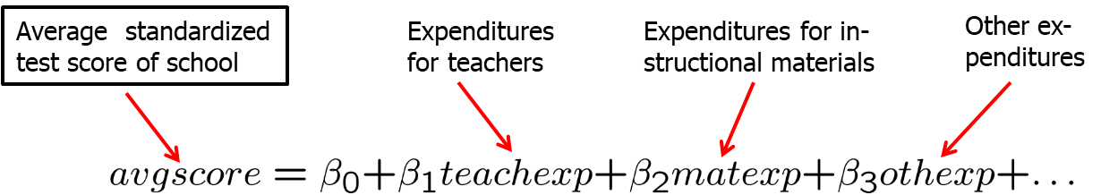
Multiple Regression Analysis: Estimation (26 of 37)
An example for multicollinearity
The different expenditure categories will be strongly correlated because if a school has a lot of resources it will spend a lot on everything.
It will be hard to estimate the differential effects of different expenditure categories because all expenditures are either high or low. For precise estimates of the differential effects, one would need information about situations where expenditure categories change differentially.
As a consequence, sampling variance of the estimated effects will be large.

Slide 28
Multiple Regression Analysis: Estimation (27 of 37)
Discussion of the multicollinearity problem
In the above example, it would probably be better to lump all expen-diture categories together because effects cannot be disentangled.
In other cases, dropping some independent variables may reduce multicollinearity (but this may lead to omitted variable bias).

Slide 29
Multiple Regression Analysis: Estimation (28 of 37)
Only the sampling variance of the variables involved in multicollinearity will be inflated; the estimates of other effects may be very precise.
Note that multicollinearity is not a violation of MLR.3 in the strict sense.
Multicollinearity may be detected through “variance inflation factors.”

Slide 30
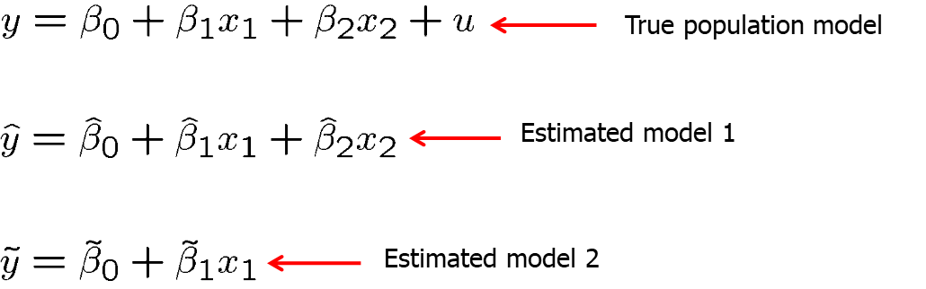
Multiple Regression Analysis: Estimation (29 of 37)
Variances in misspecified models
The choice of whether to include a particular variable in a regression can be made by analyzing the tradeoff between bias and variance.
It might be the case that the likely omitted variable bias in the misspecified model 2 is overcompensated by a smaller variance.

Slide 31
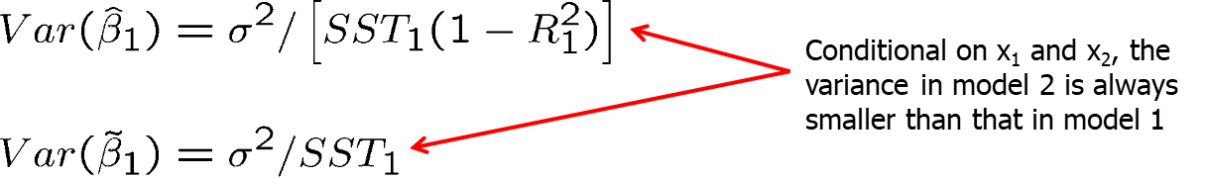
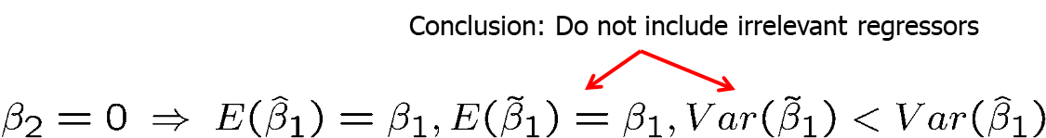
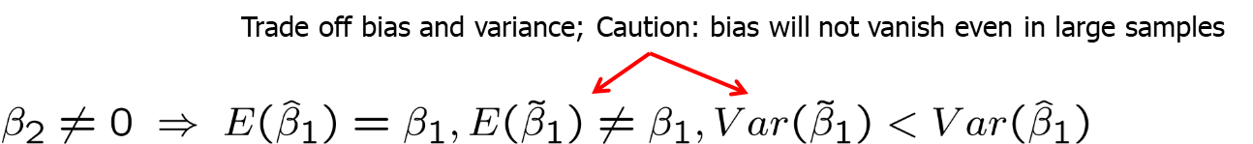
Multiple Regression Analysis: Estimation (30 of 37)
Variances in misspecified models (cont.)
Case 1:
Case 2:

Slide 32
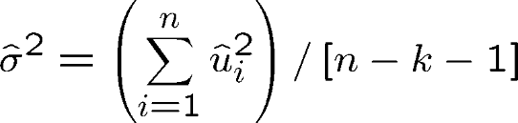
Multiple Regression Analysis: Estimation (31 of 37)
Estimating the error variance
An unbiased estimate of the error variance can be obtained by substracting the number of estimated regression coefficients from the number of observations. The number of observations minus the number of estimated parameters is also called the degrees of freedom. The n estimated squared residuals in the sum are not completely independent but related through the k+1 equations that define the first order conditions of the minimization problem.
Theorem 3.3 (Unbiased estimator of the error variance)

Slide 33
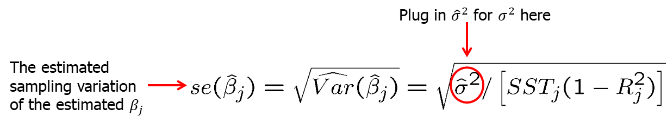
Multiple Regression Analysis: Estimation (32 of 37)
Estimation of the sampling variances of the OLS estimators
Note that these formulas are only valid under assumptions MLR.1-MLR.5 (in particular, there has to be homoskedasticity)

Slide 34
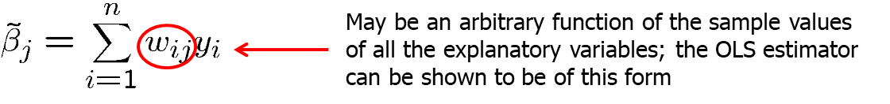
Multiple Regression Analysis: Estimation (33 of 37)
Efficiency of OLS: The Gauss-Markov Theorem
Under assumptions MLR.1 - MLR.5, OLS is unbiased
However, under these assumptions there may be many other estimators that are unbiased.
Which one is the unbiased estimator with the smallest variance?
In order to answer this question one usually limits oneself to linear estimators, i.e. estimators linear in the dependent variable.

Slide 35
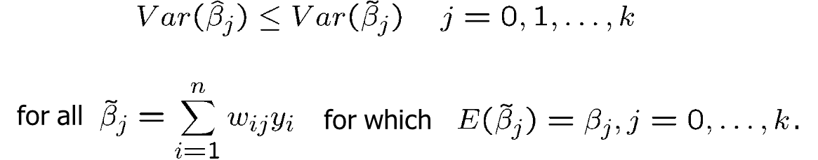
Multiple Regression Analysis: Estimation (34 of 37)
Theorem 3.4 (Gauss-Markov Theorem)
Under assumptions MLR.1 - MLR.5, the OLS estimators are the best linear unbiased estimators (BLUEs) of the regression coefficients, i.e.
OLS is only the best estimator if MLR.1 – MLR.5 hold; if there is heteroskedasticity for example, there are better estimators.

Slide 36
Multiple Regression Analysis: Estimation (35 of 37)
Several Scenarios for Applying Multiple Regression
Prediction
The best prediction of y will be its conditional expectation
Efficient markets
Efficient markets theory states that a single variable acts as a sufficient statistic for predicting y . Once we know this sufficient statistic, then additional information is not useful in predicting y.

Slide 37
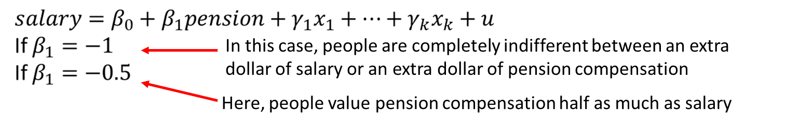
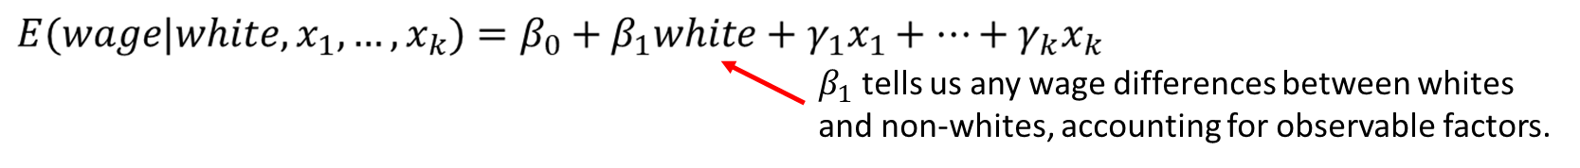
Multiple Regression Analysis: Estimation (36 of 37)
Several Scenarios for Applying Multiple Regression (contd.)
Measuring the tradeoff between two variables
Consider regressing salary on pension compensation and other controls
Testing for ceteris paribus group differences
Differences in outcomes between groups can be evaluated with dummy variables

Slide 38
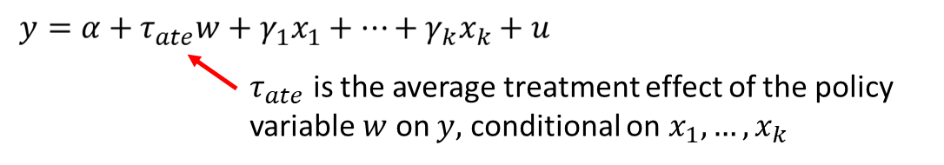
Multiple Regression Analysis: Estimation (37 of 37)
Several Scenarios for Applying Multiple Regression (contd.)
Potential outcomes, treatment effects, and policy analysis
With multiple regression, we can get closer to random assignment by conditioning on observables.
Inclusion of the x variables allows us to control for any reasons why there may not be random assignment.
For example, if y is earnings and w is participation in a job training program, then the variables in x would include all of those variables that are likely to be related to both earnings and participation in job training.

